Slide 1
Muzeum eTwinning
Reprodukcja obrazu “Portret dzieci artysty” J. Matejko.

Slide 2
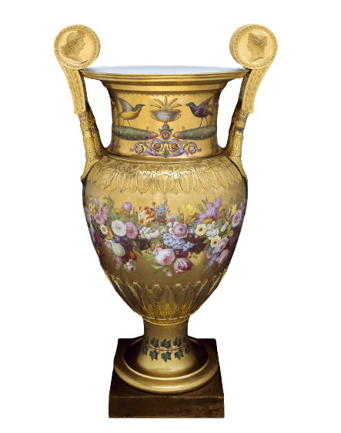
ROOMS C & D
ROOM
A
ROOM
B

Slide 3
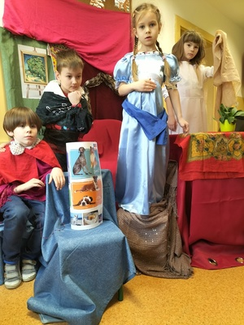
ROOM
A

Slide 4
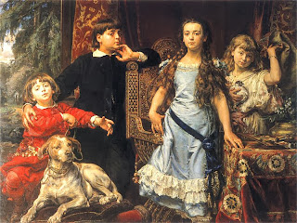
ROOM
B

Slide 5
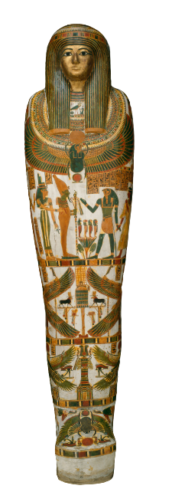
ROOMS E & F
ROOM
C
ROOM
D

Slide 6
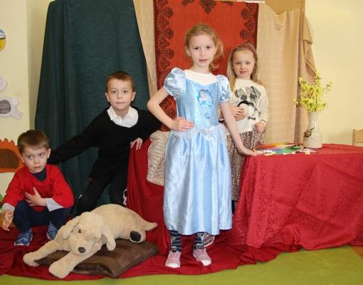
ROOM
C

Slide 7
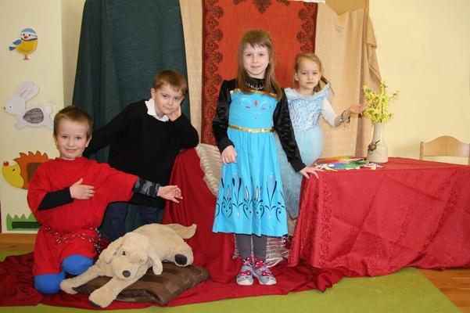
ROOM
D

Slide 8
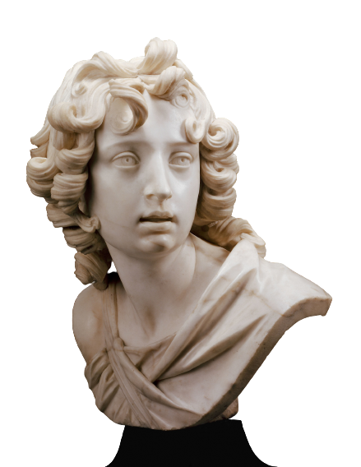
ROOMS G & H
ROOM
E
ROOM
F

Slide 9
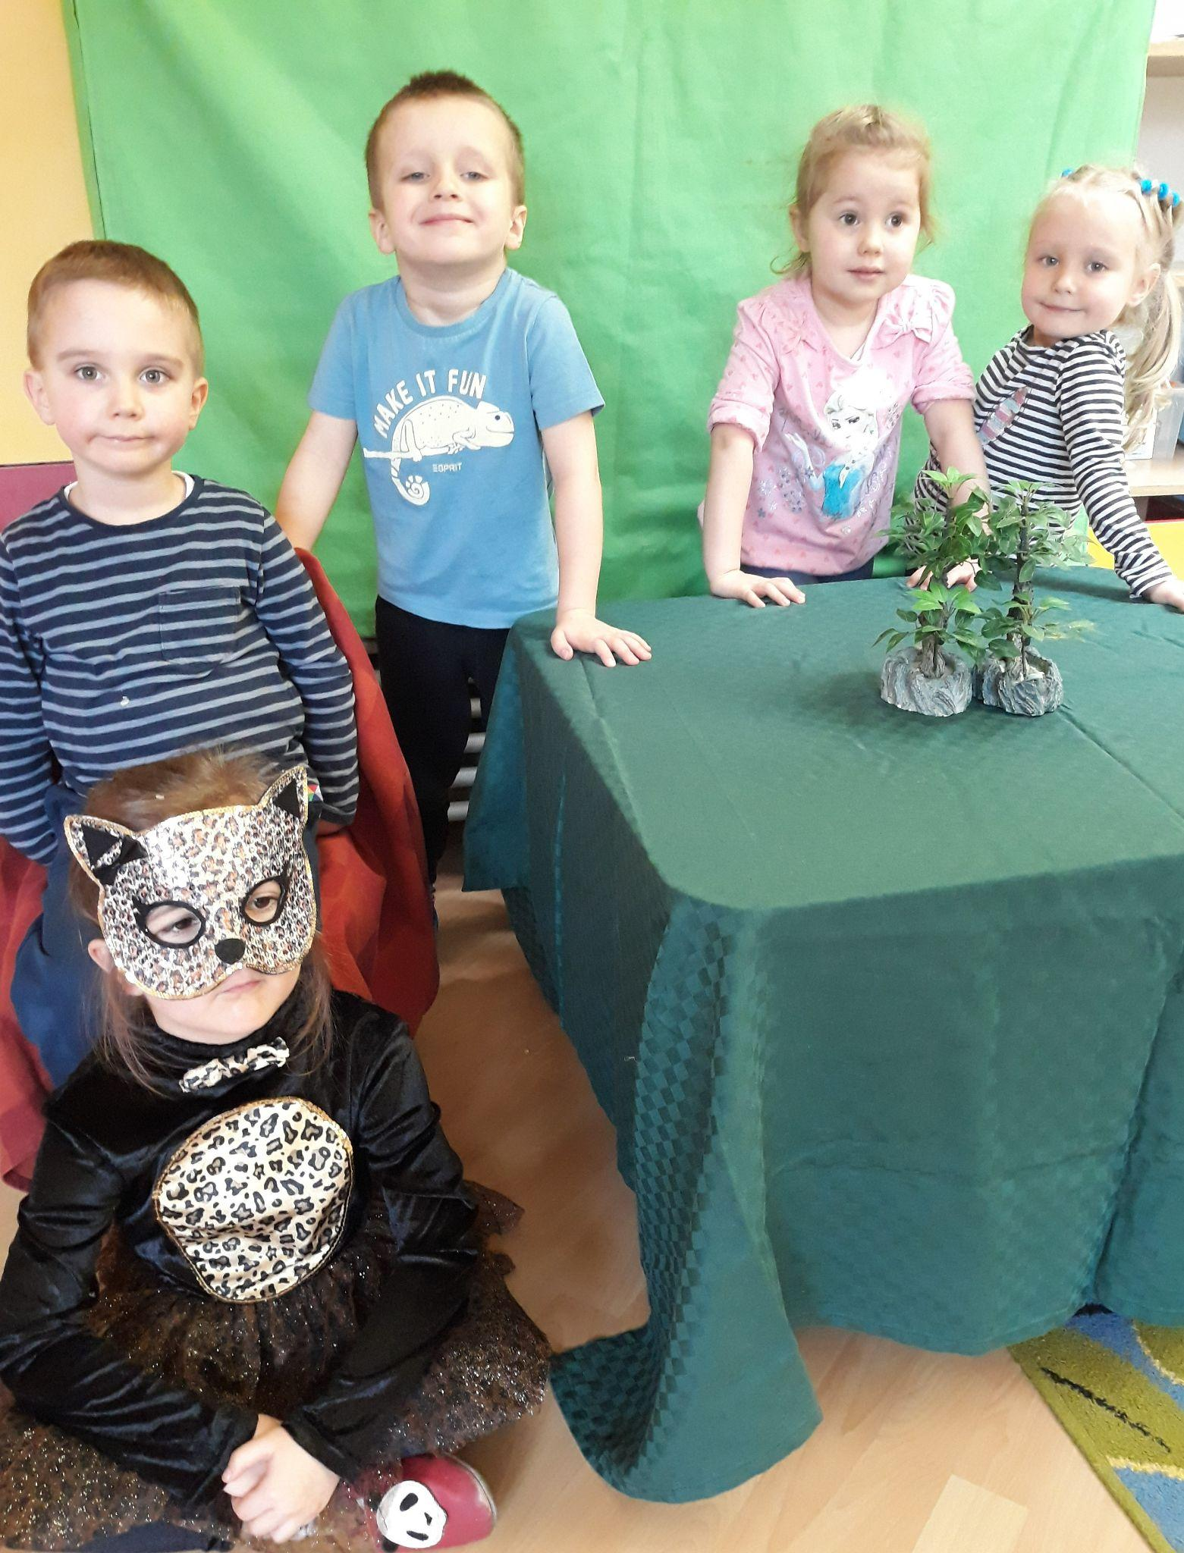
ROOM
E

Slide 10
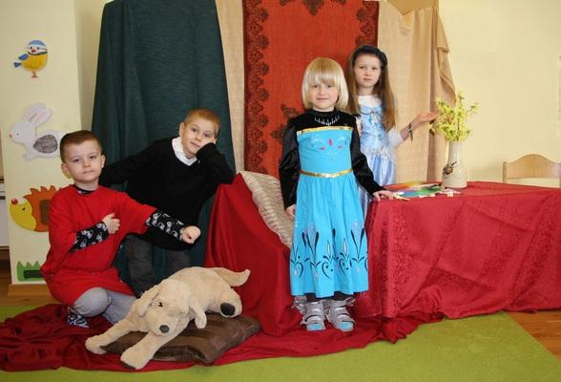
ROOM
F

Slide 11
ROOMS I & J
ROOM
G
ROOM
H

Slide 12
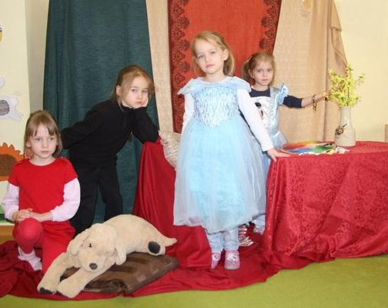
ROOM
G

Slide 13
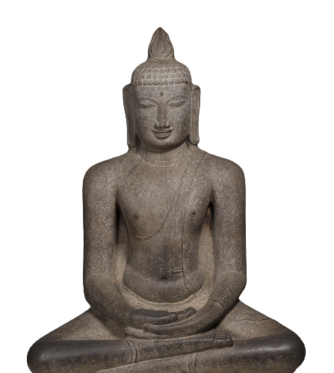
ROOM
H

Slide 14
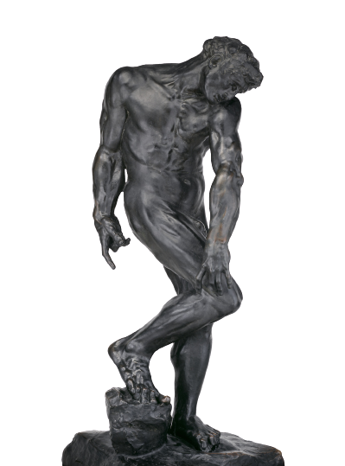
ROOMS K & L
ROOM
I
ROOM
J

Slide 15
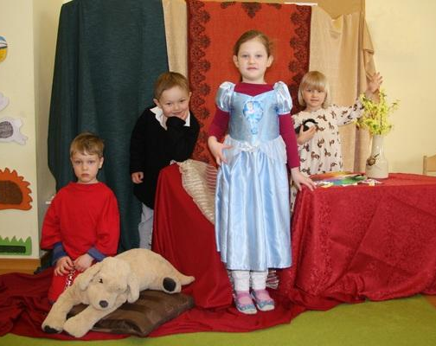
ROOM
I

Slide 16
ROOM
J

Slide 17
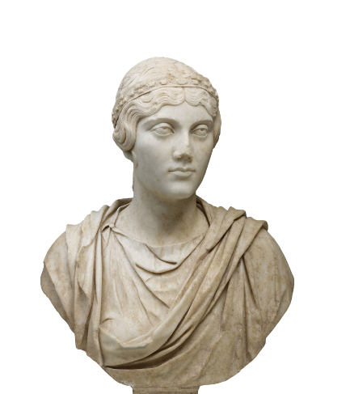
ROOMS M & N
ROOM
K
ROOM
L

Slide 18
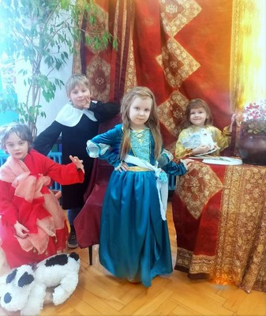
ROOM
K

Slide 19
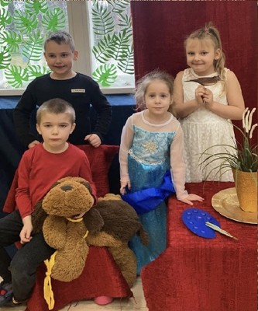
ROOM
L

Slide 20
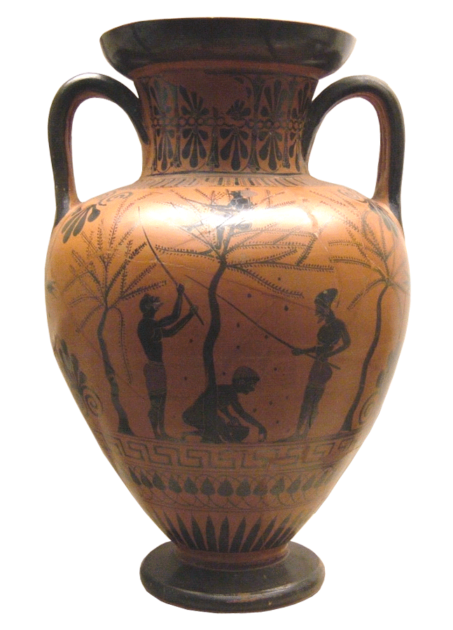
ROOMS O & P
ROOM
M
ROOM
N

Slide 21
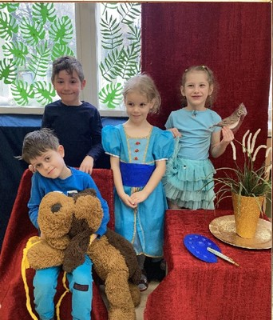
ROOM
M

Slide 22
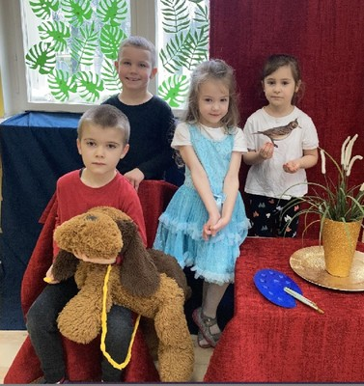
ROOM
N

Slide 23
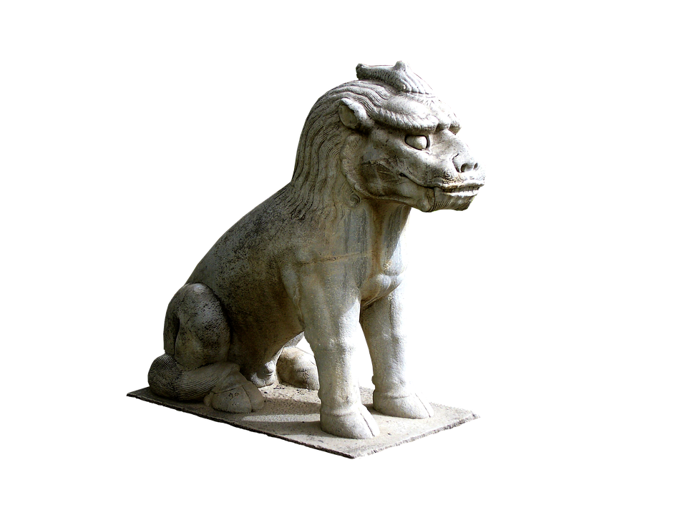
ROOMS Q & R
ROOM
O
ROOM
P

Slide 24
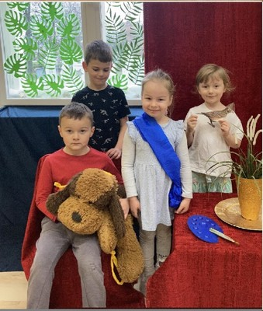
ROOM
O

Slide 25
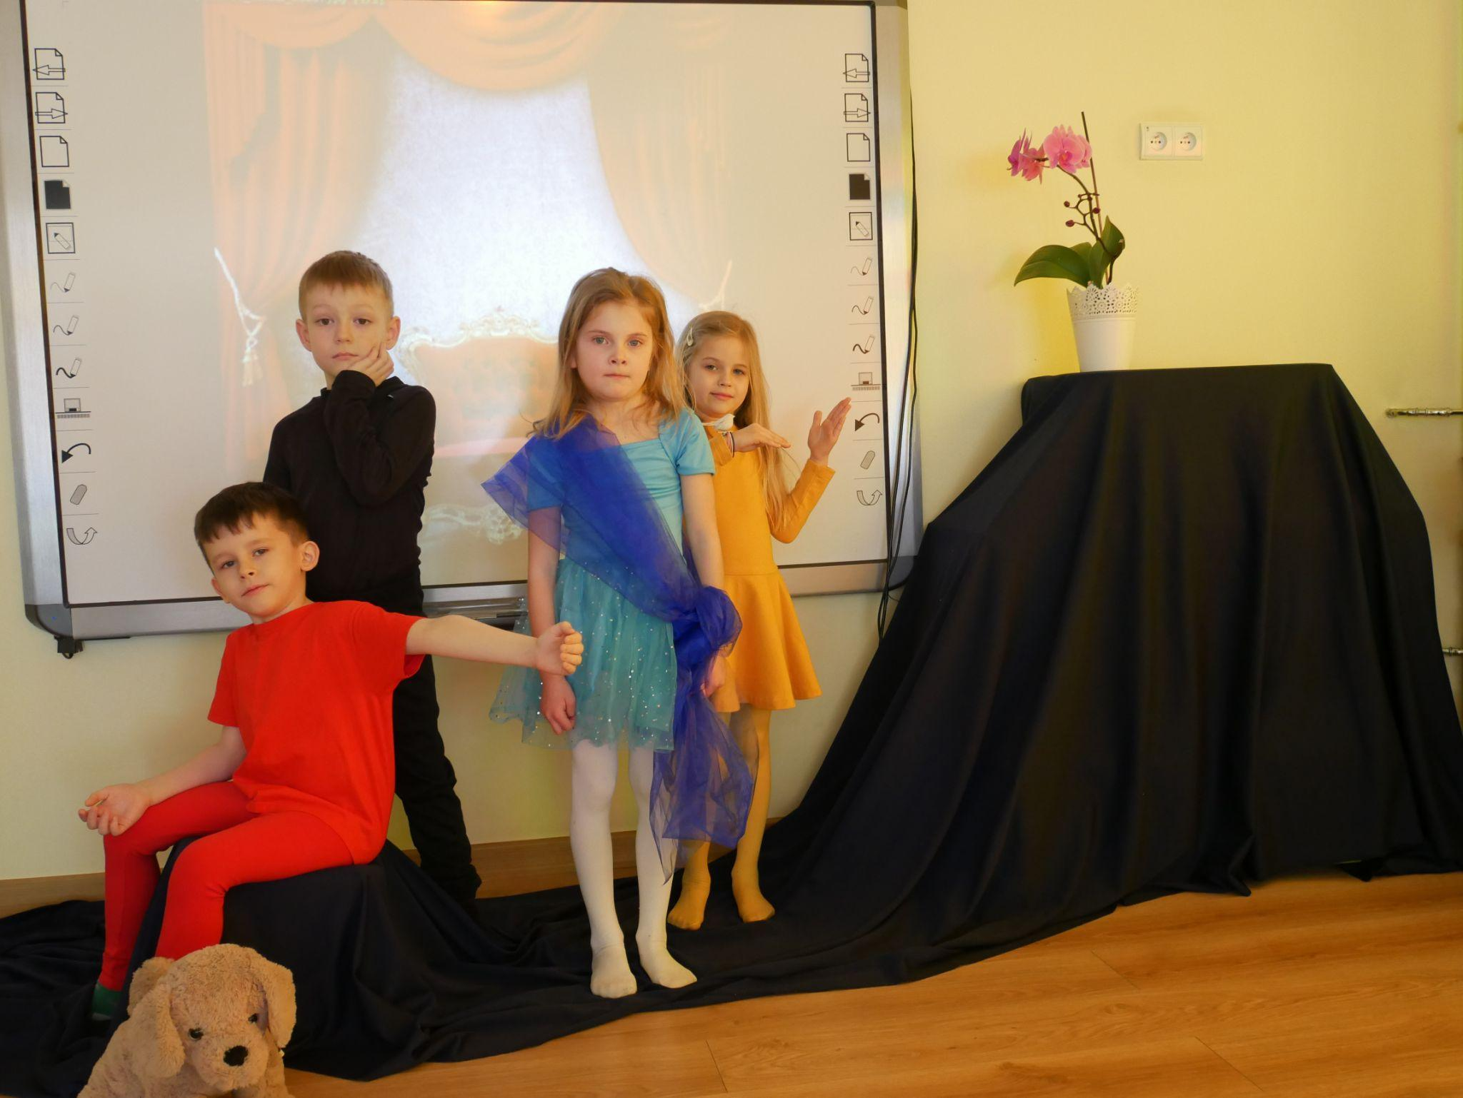
ROOM
P

Slide 26
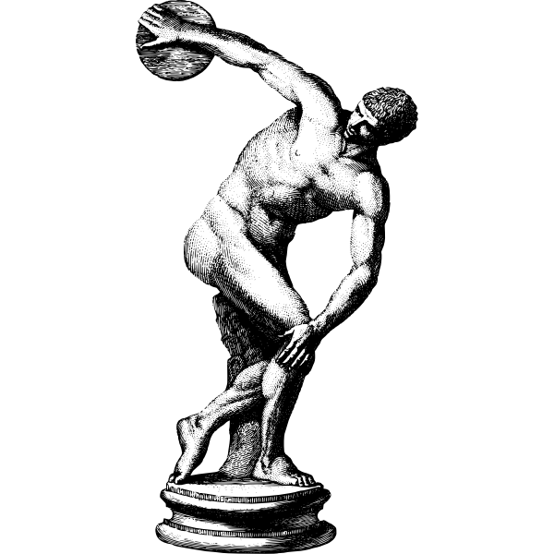
ROOMS S & T
ROOM
Q
ROOM
R

Slide 27
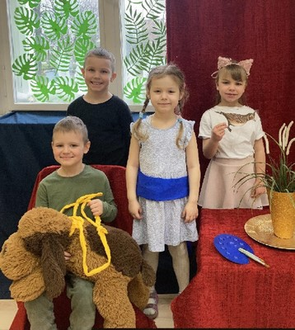
ROOM
Q

Slide 28
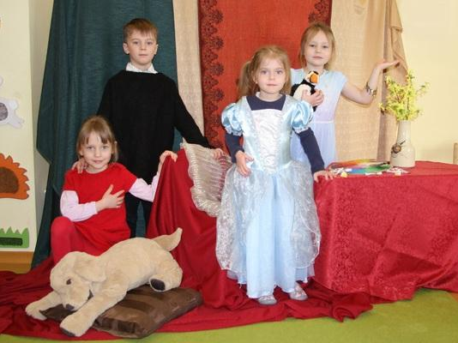
ROOM
R

Slide 29
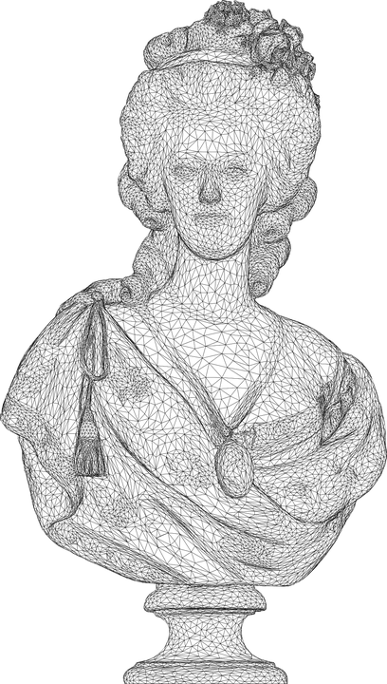
ROOMS U & V
ROOM
S
ROOM
T

Slide 30
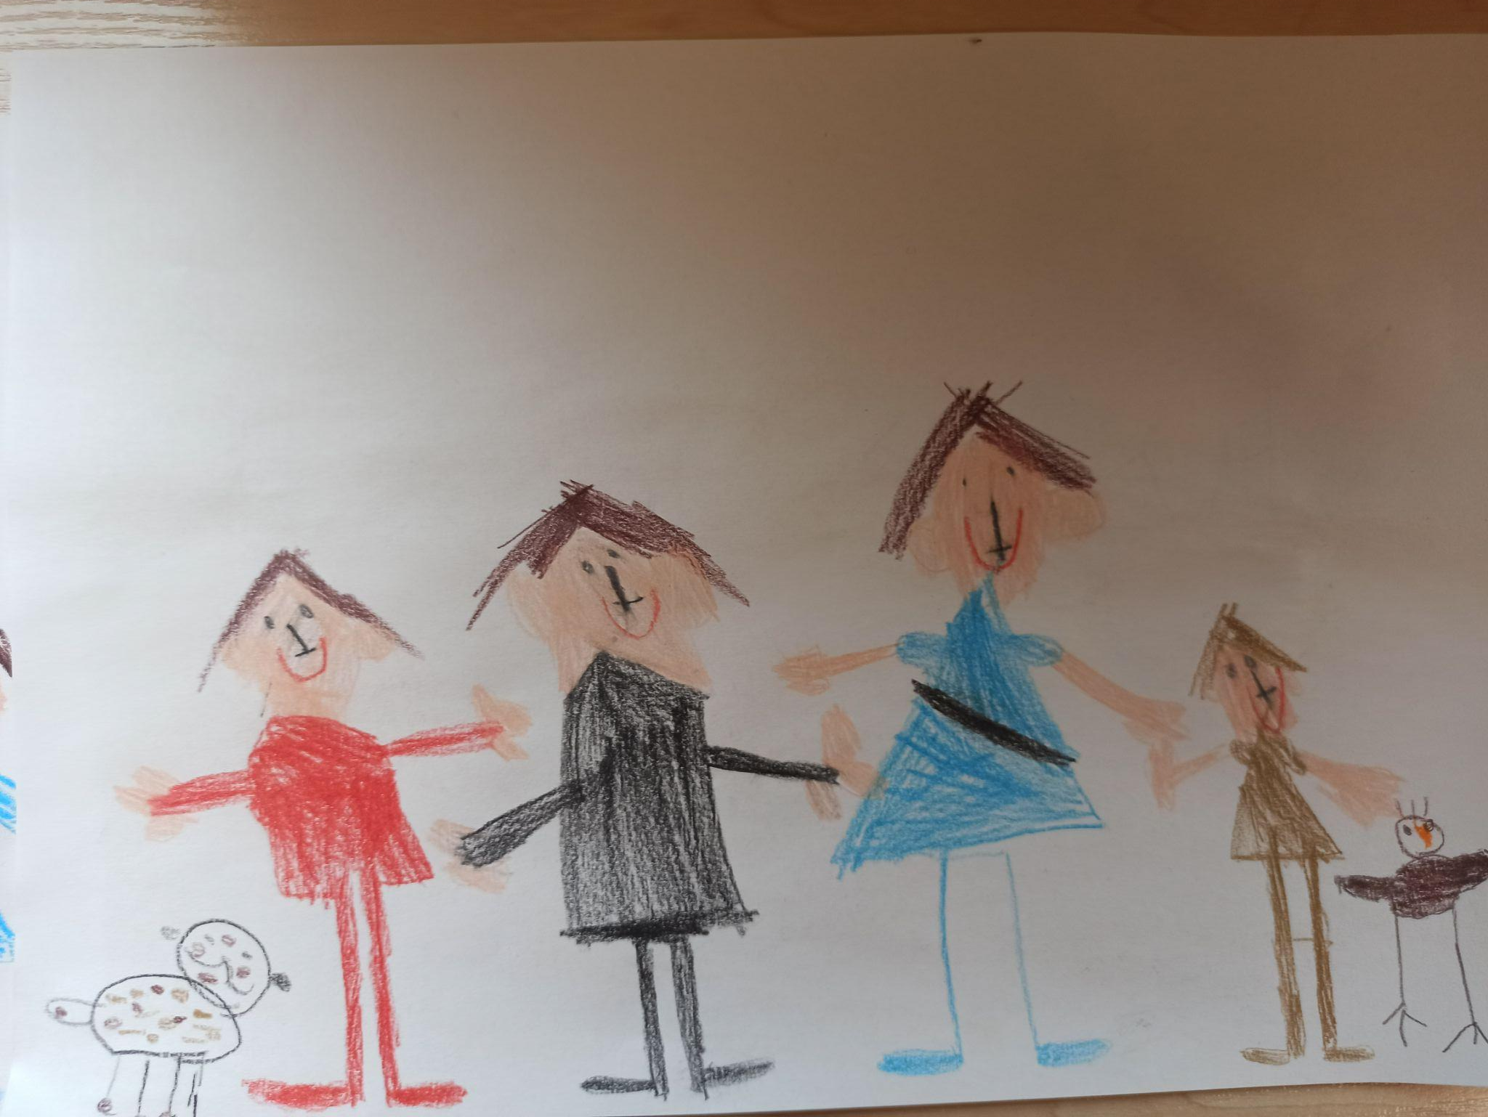
ROOM
S

Slide 31
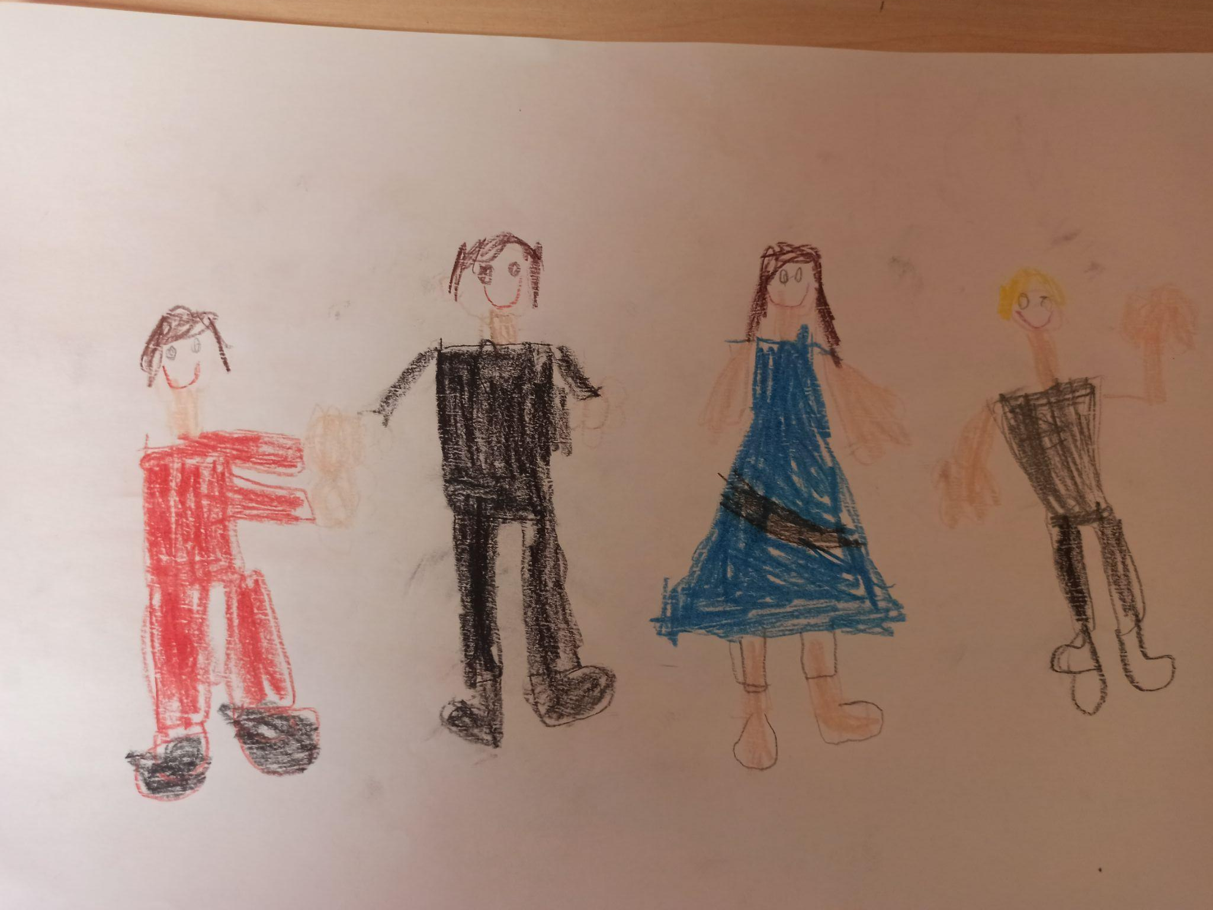
ROOM
T

Slide 32
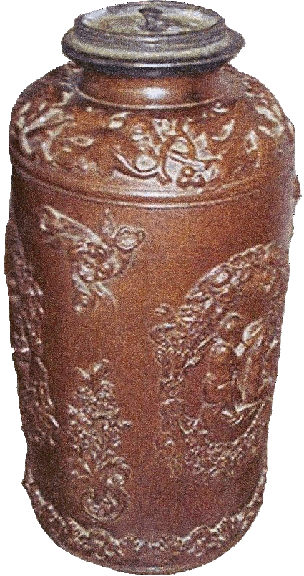
ROOMS W & X
ROOM
U
ROOM
V

Slide 33
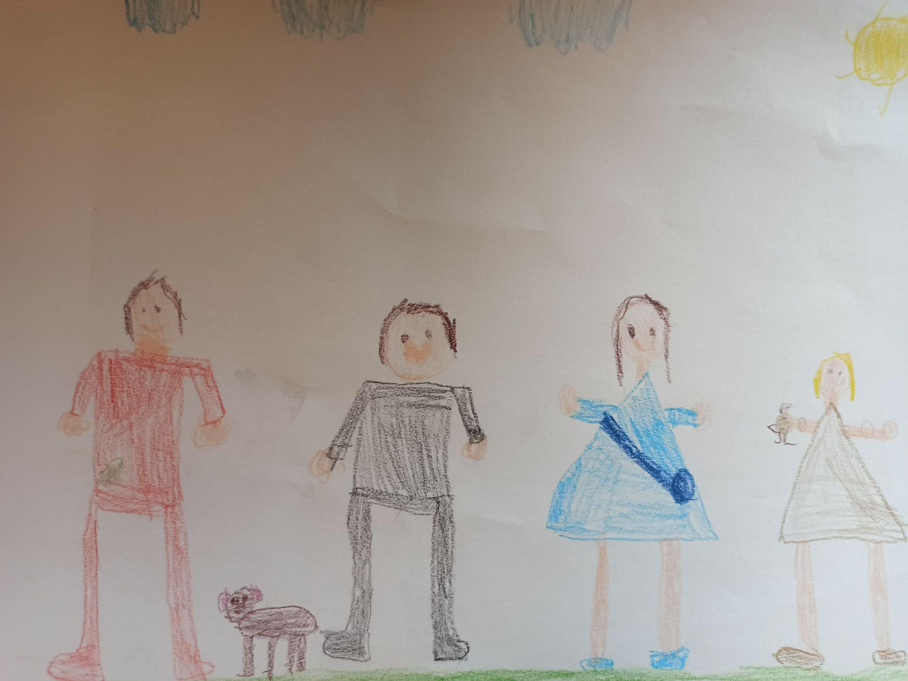
ROOM
U

Slide 34
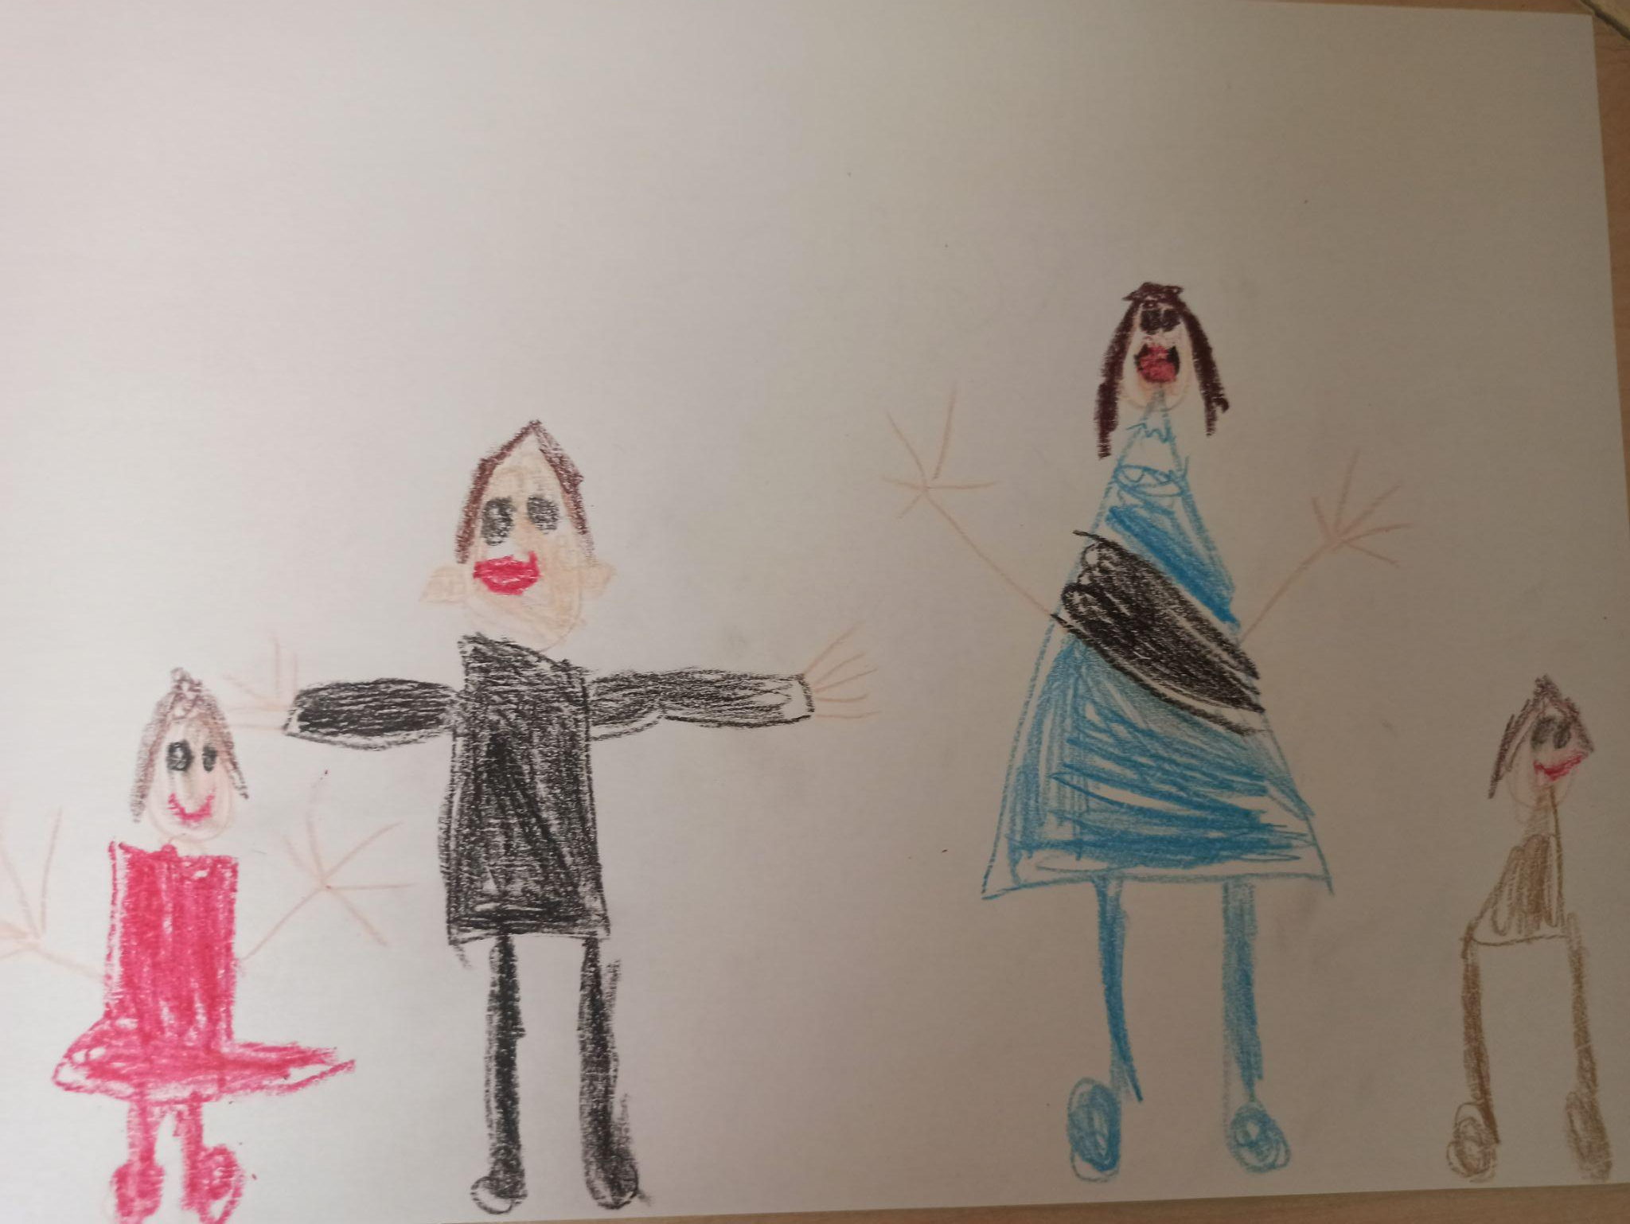
ROOM
V

Slide 35
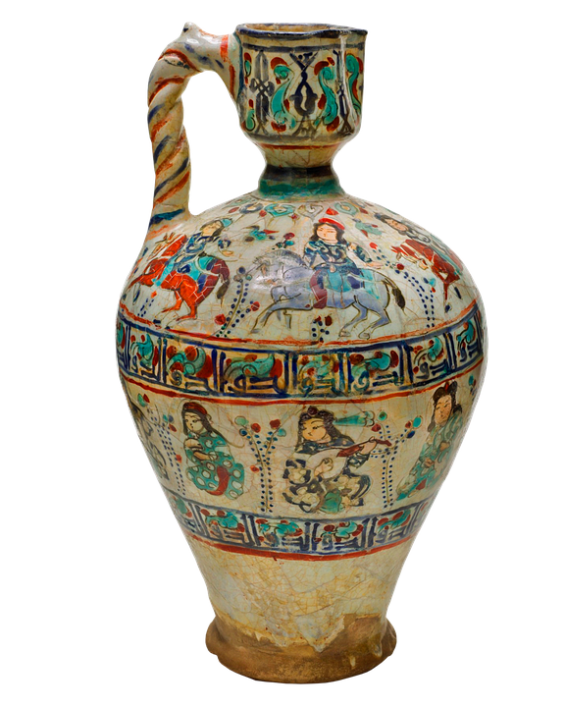
ROOMS Y & Z
ROOM
W
ROOM
X

Slide 36
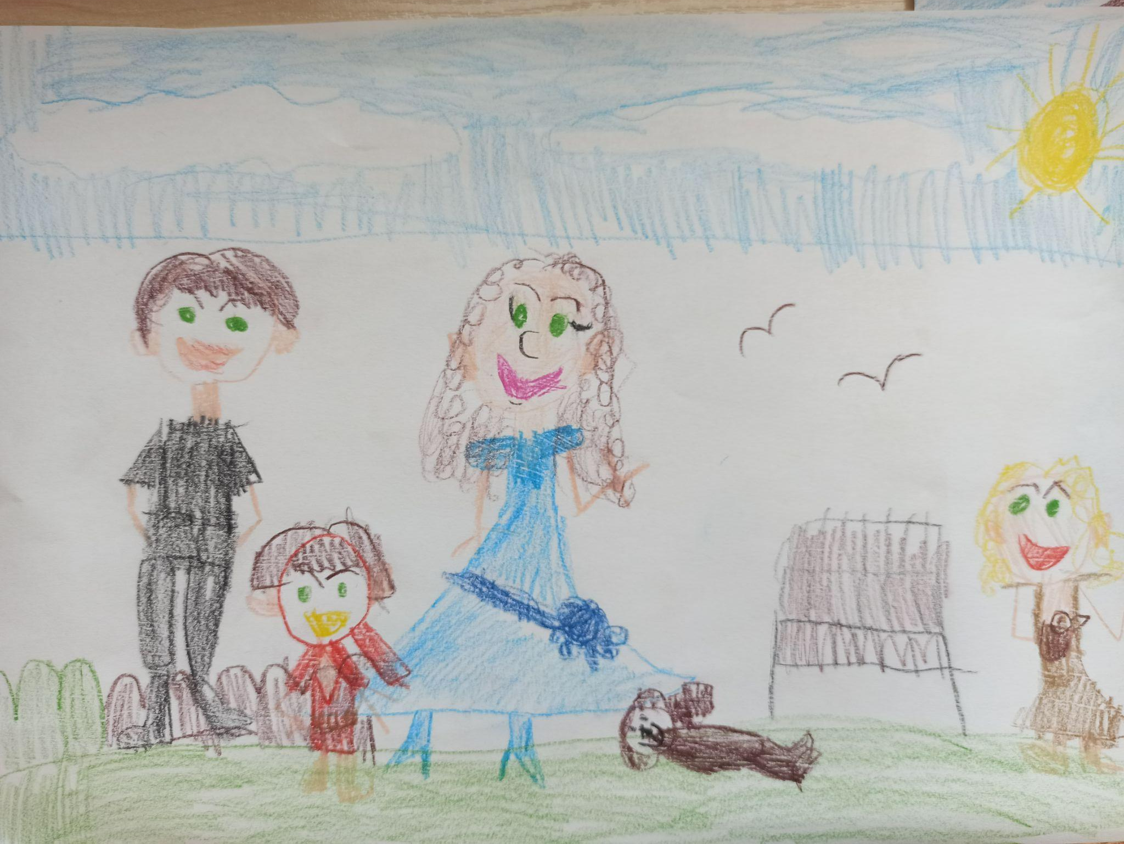
ROOM
W

Slide 37
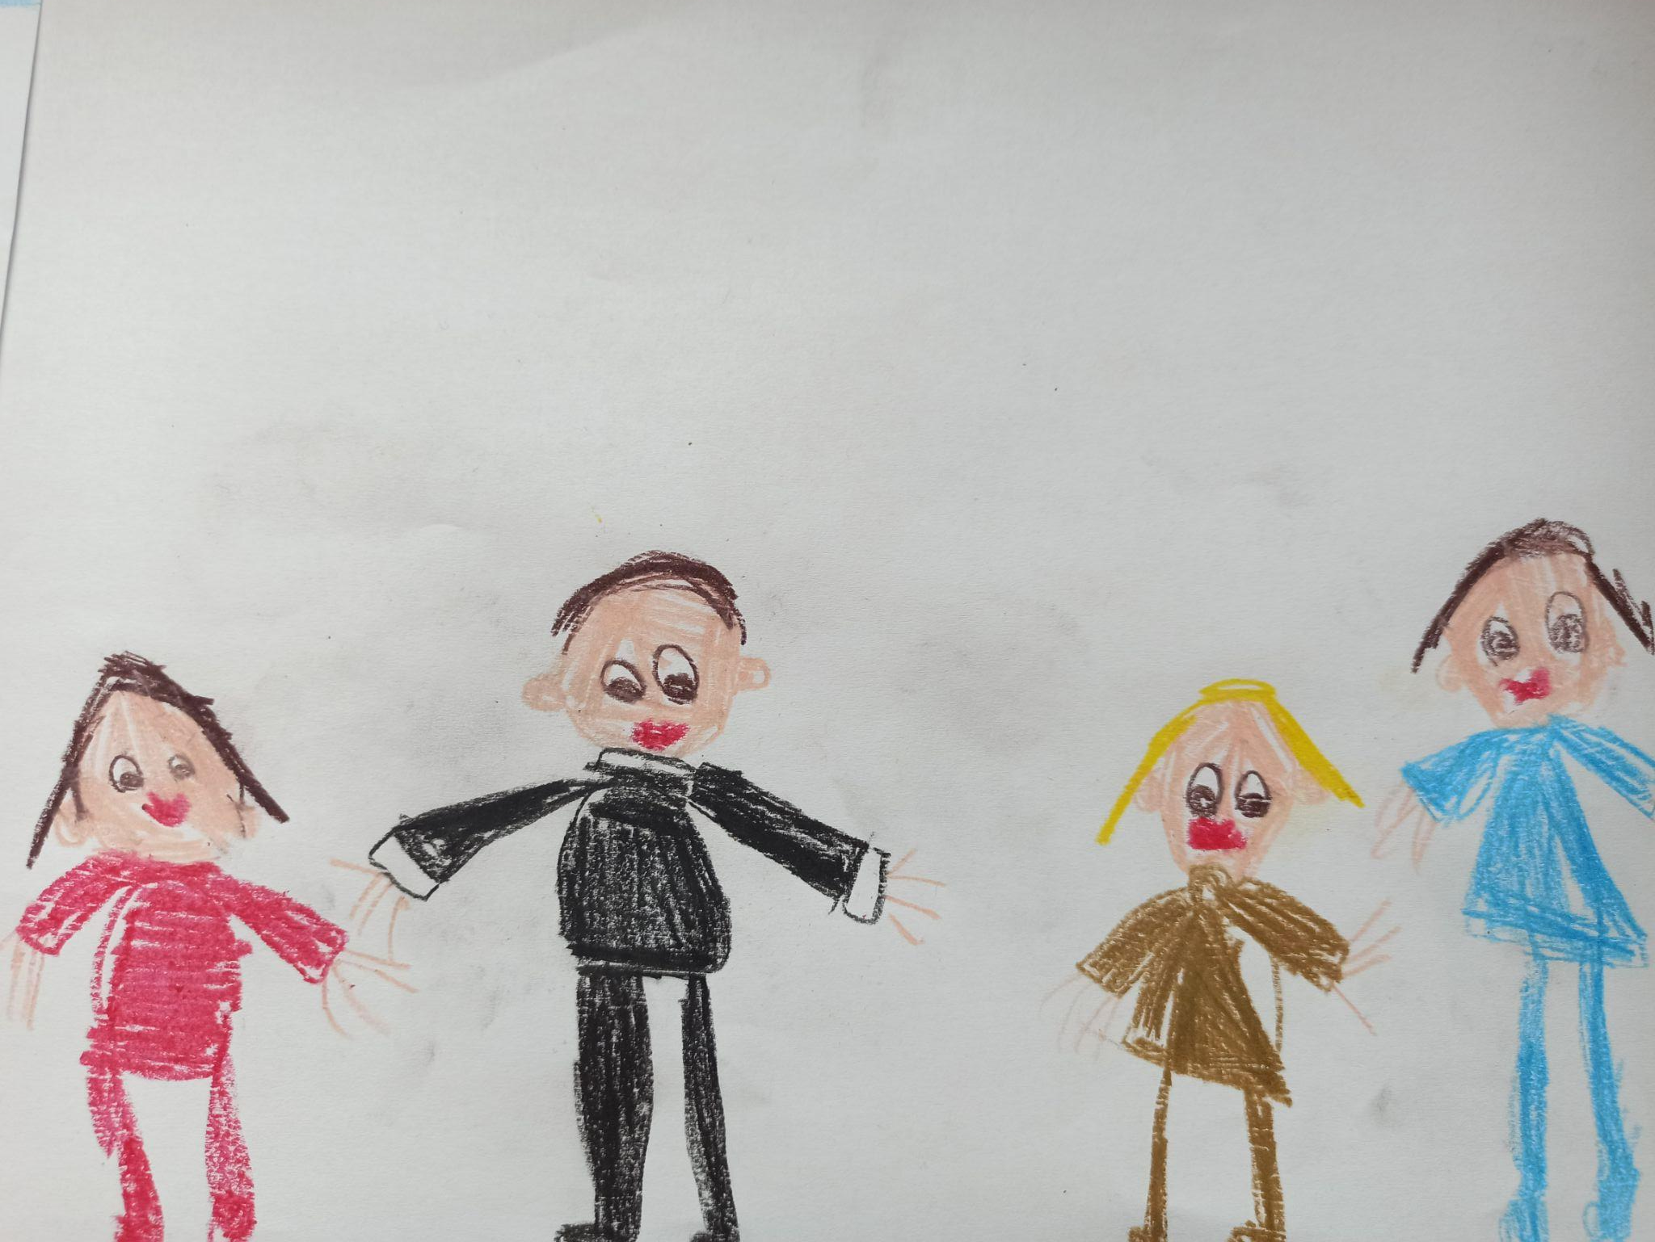
ROOM
X

Slide 38
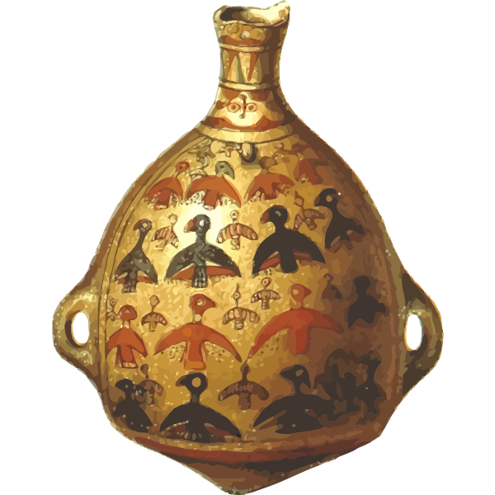
EXIT
ROOM
Y
ROOM
Z

Slide 39
ROOM
Y

Slide 40
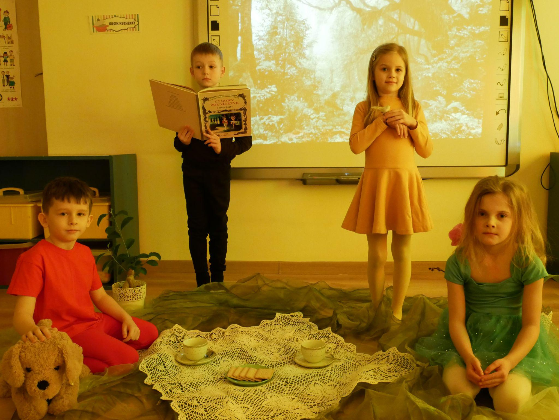
ROOM
Z

Slide 41
Kurator wystawy:
Anna Urbasik
Autorzy reprodukcji:
Uczestnicy projektu eTwinning “Ile matematyki jest w obrazie?”

